Slide 1
Chapter 5： Geovisualization+
Alukardo

Slide 2
Countries
Step #1 : new layer
Step #2 : new data
Step #3 : render
index.js

Slide 3
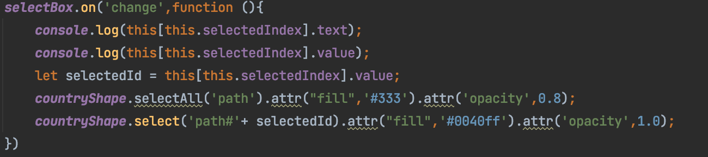
Using Select Box

Slide 4
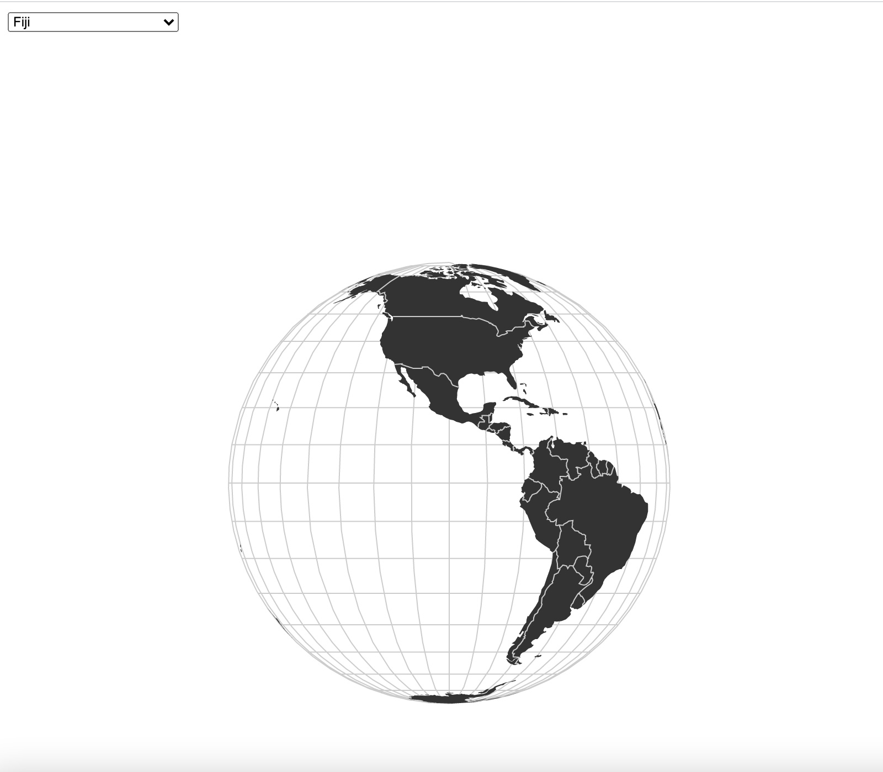
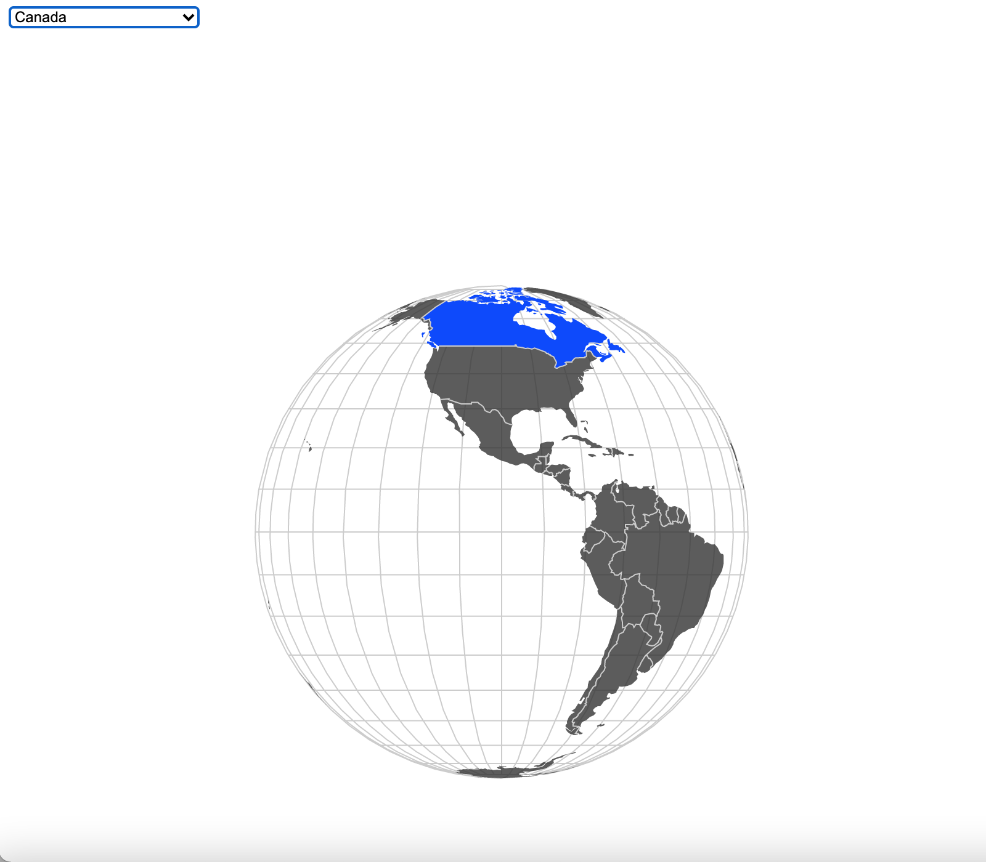
Let's see the effect

Slide 5
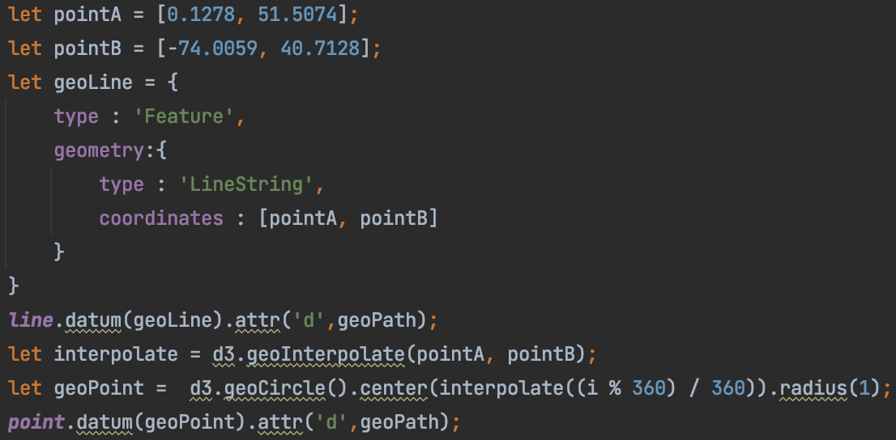
How to add some markers?
Step #1 : new layer
Step #2 : data & render

Slide 6
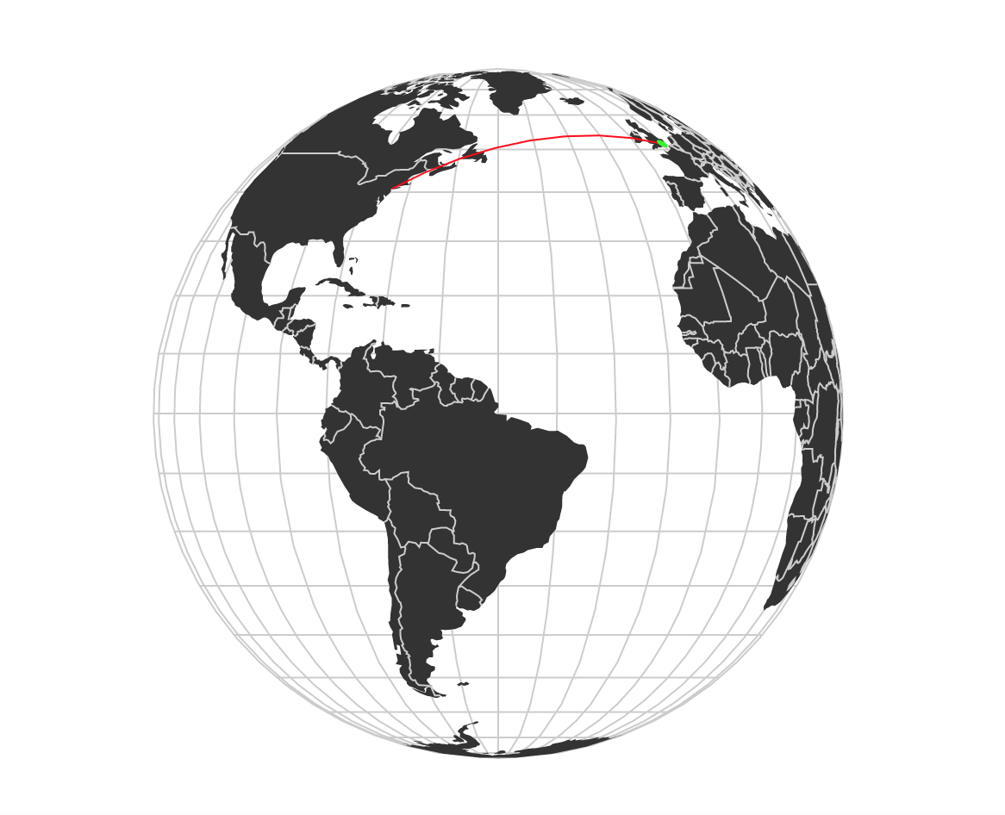
How about the appearance?

