Slide 1
Chapter 4： Geovisualization
Alukardo

Slide 2
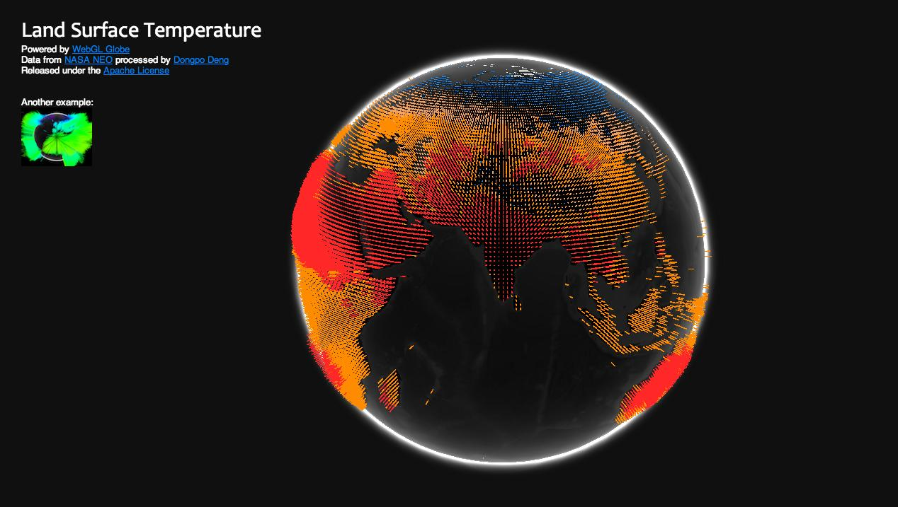
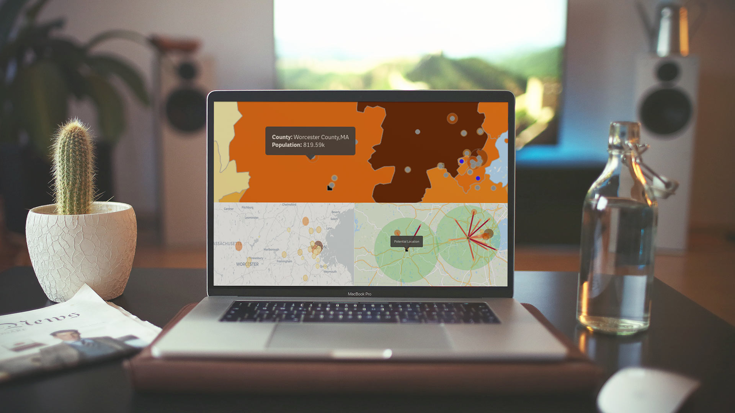
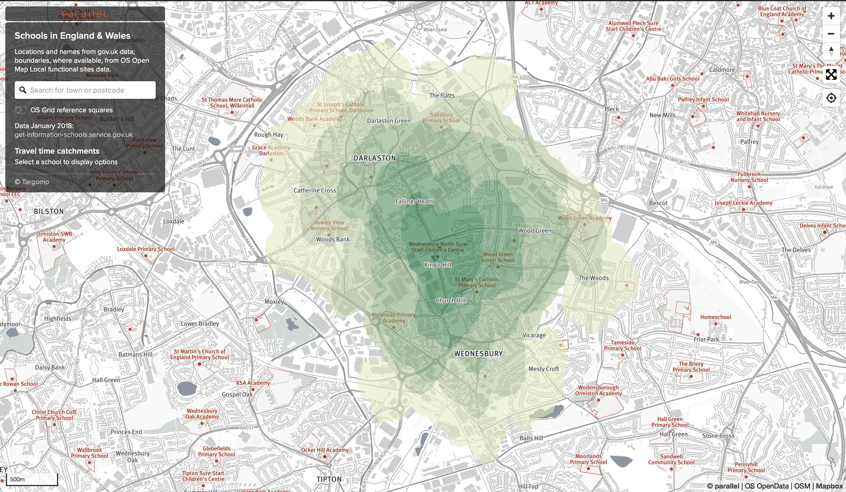
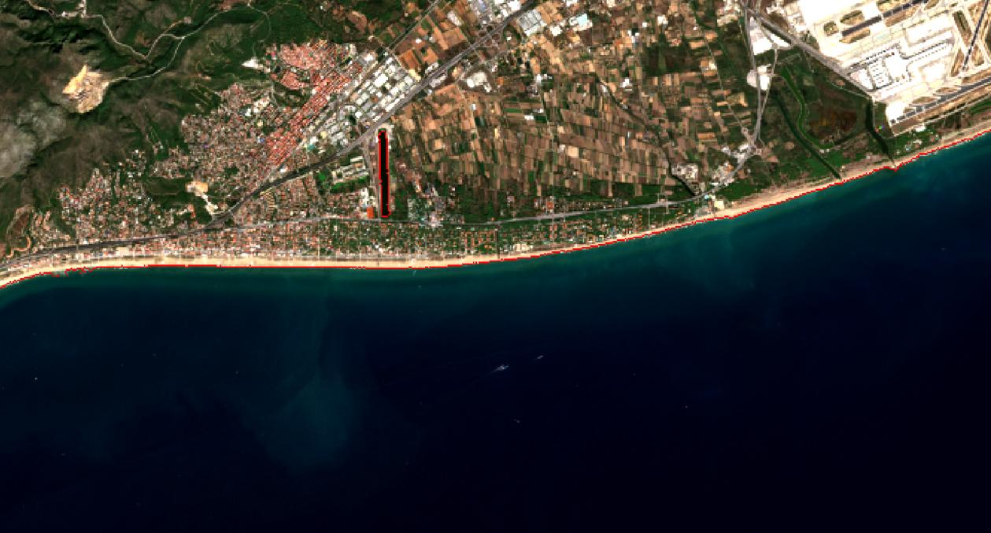
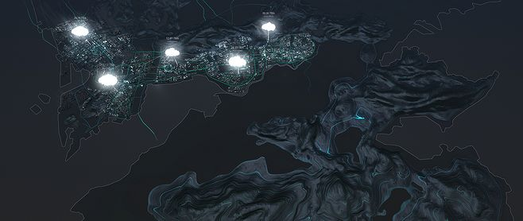
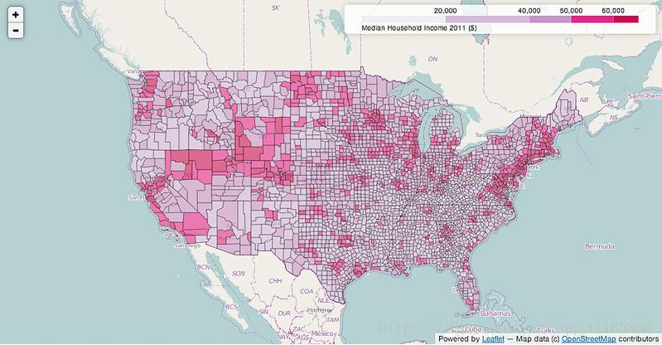
Introduction

Slide 3
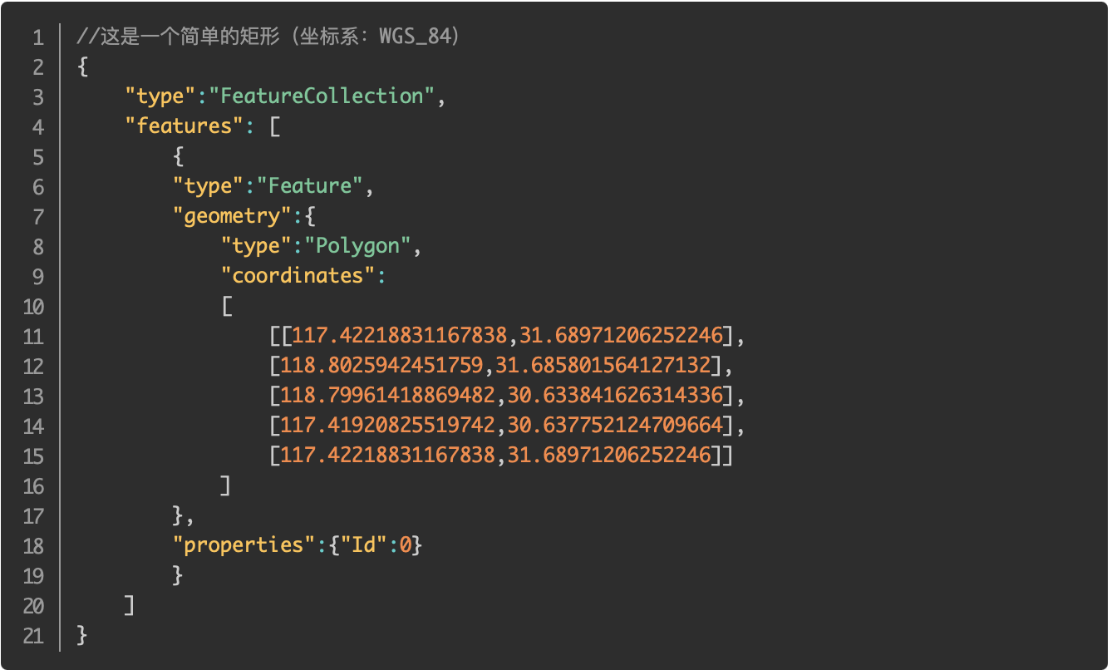
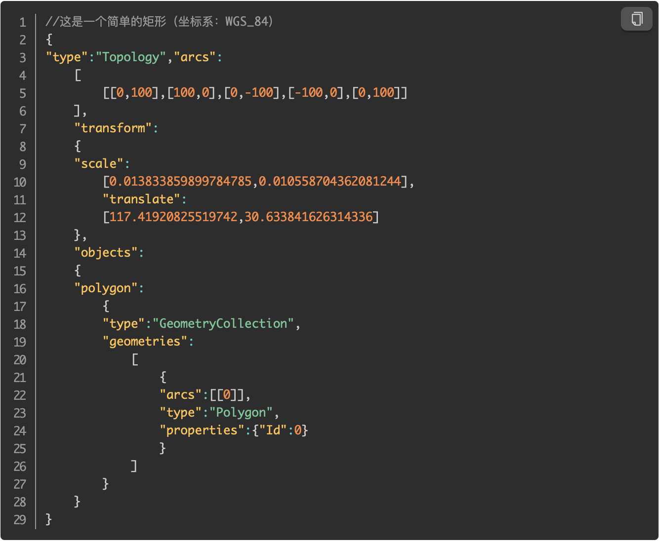
Geo Info Data
https://www.jianshu.com/p/465702337744
GeoJson
TopoJson

Slide 4
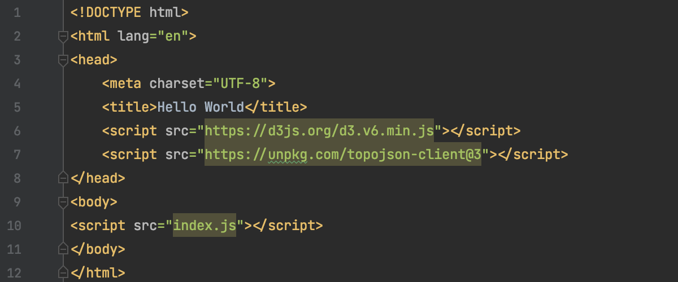
How to Using Topo
Step #1 : Import the topojson-client framework
index.html

Slide 5
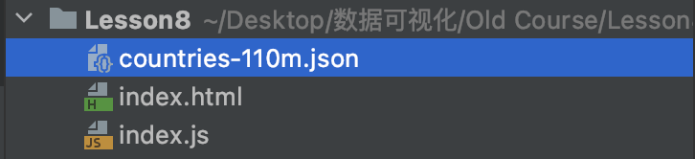

How to Using Topo
Step #2 : Load Geo Info Data
At first,“countries-110m.json”containing world map information is included in the project
Using d3.json() to load it, then We can use the variable world to render the map
index.js

Slide 6
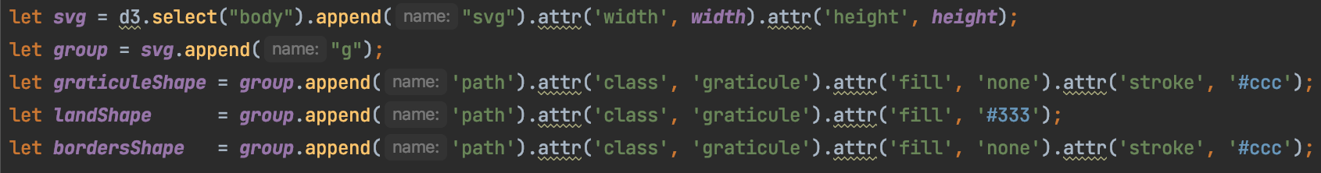
How to Using Topo
Step #3: Render
graticuleShape : Grid layer for longitude and latitude
landShape：Land layer
bordersShape： National boundary layer

Slide 7
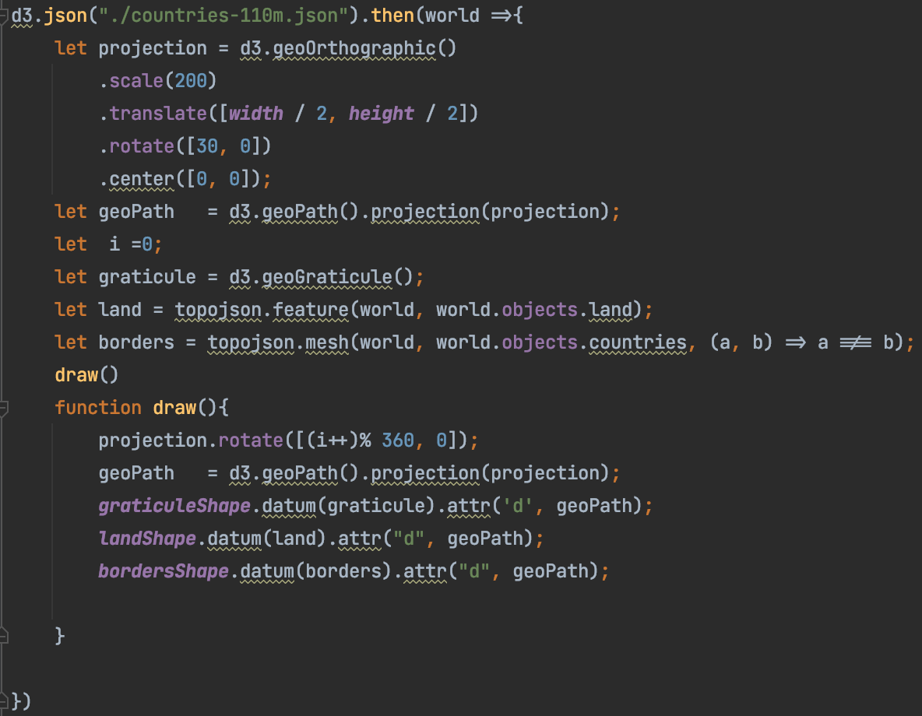
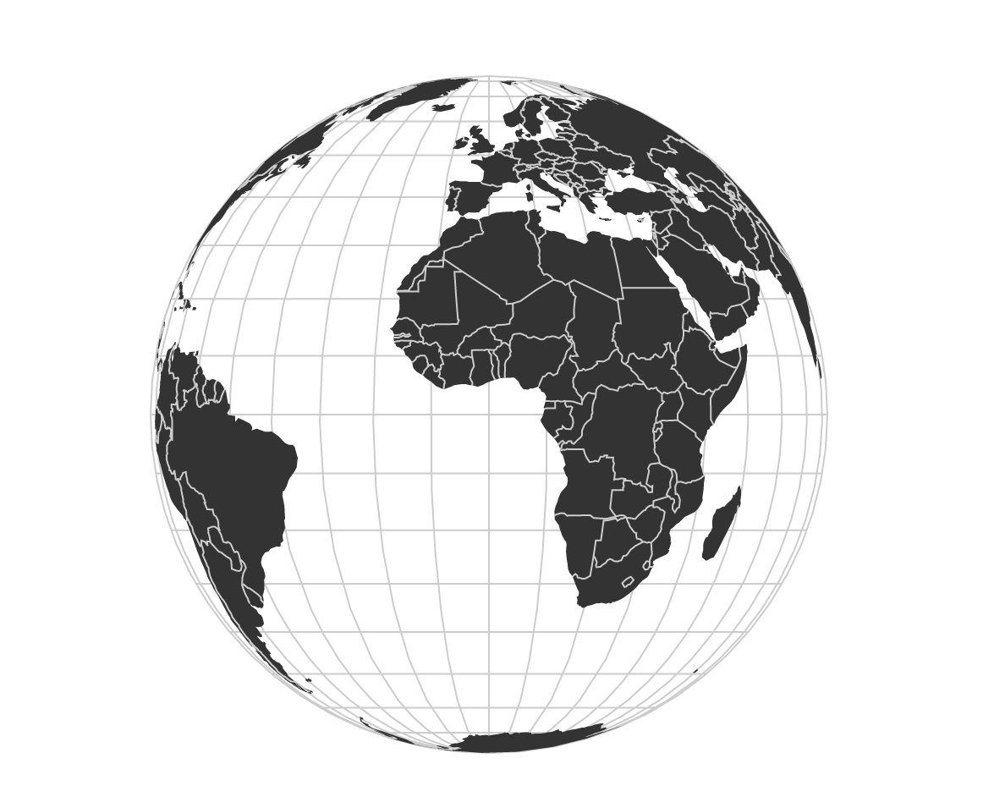
How to Using Topo
Step #3: Render
Try Use d3.interval(draw, 100); instead of draw()

