Slide 1
Chapter 2：Data Processing
Alukardo

Slide 2
Types of data
Json
CSV
Web API
JS

Slide 3
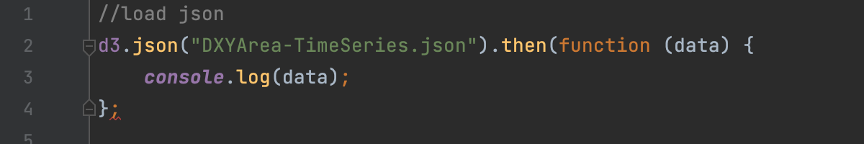
How to load
For Json

Slide 4
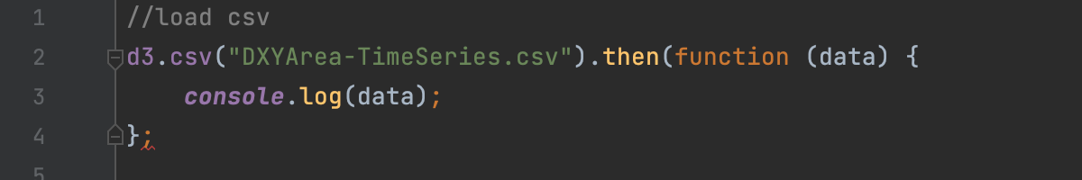
How to load
For CSV

Slide 5
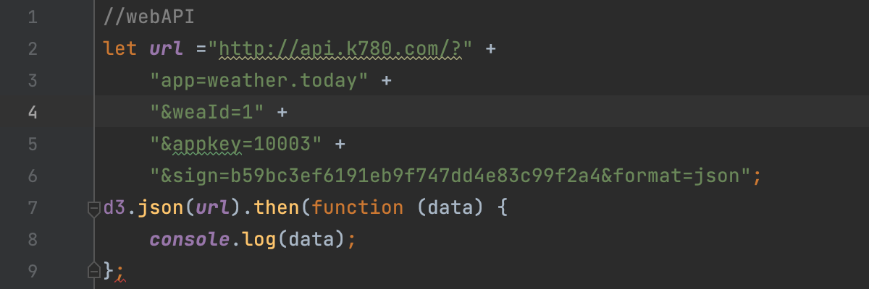
How to load
For WebAPI
PS: 如果有报No 'Access-Control-Allow-Origin' header is present on the requested resource‘
请在Html 的 <head>中加入
<meta http-equiv="Access-Control-Allow-Origin" content="*" />

Slide 6
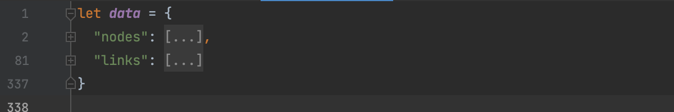
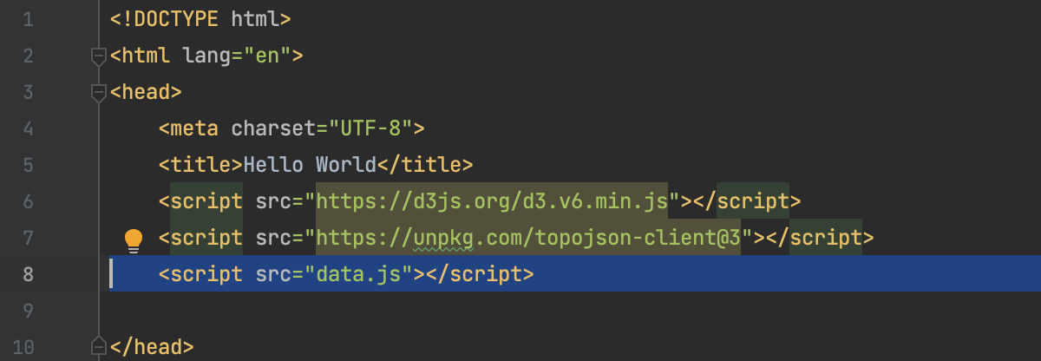
How to load
For JS
For data.js
For index.html

Slide 7
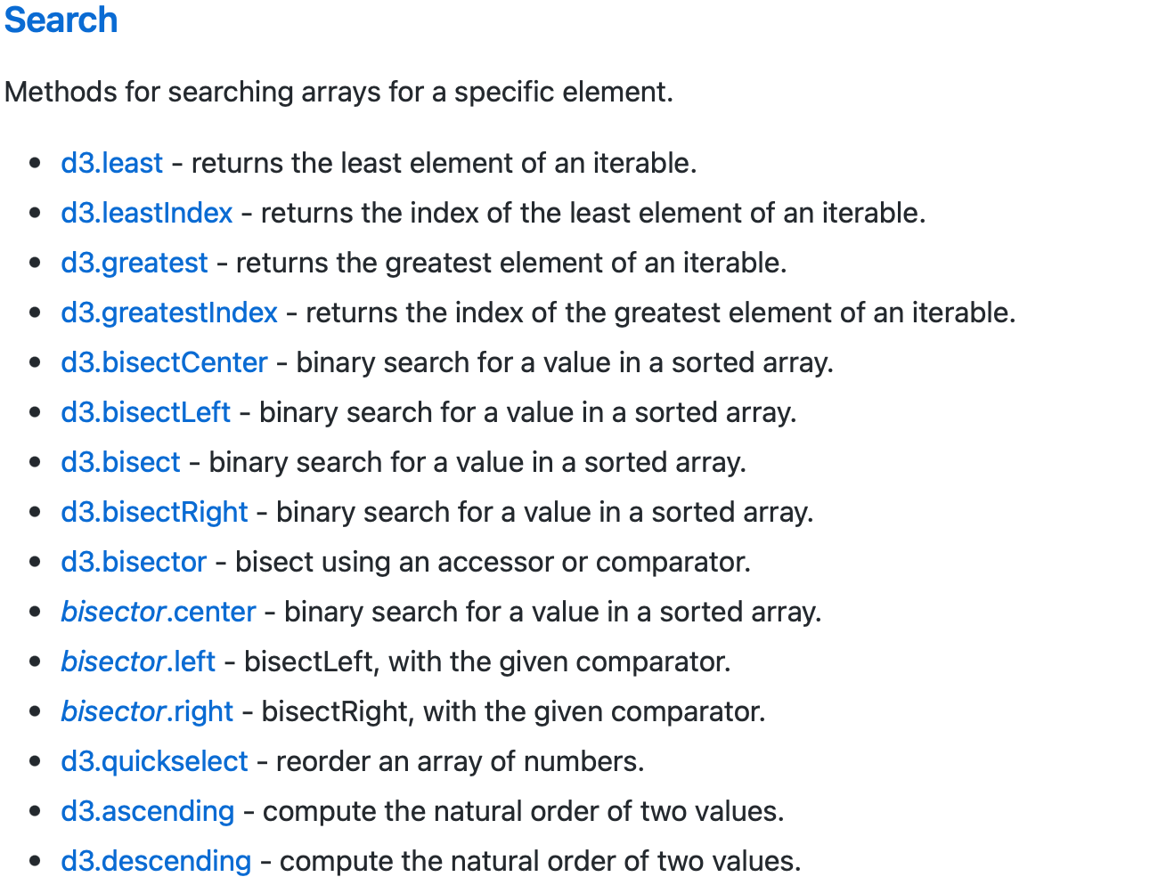
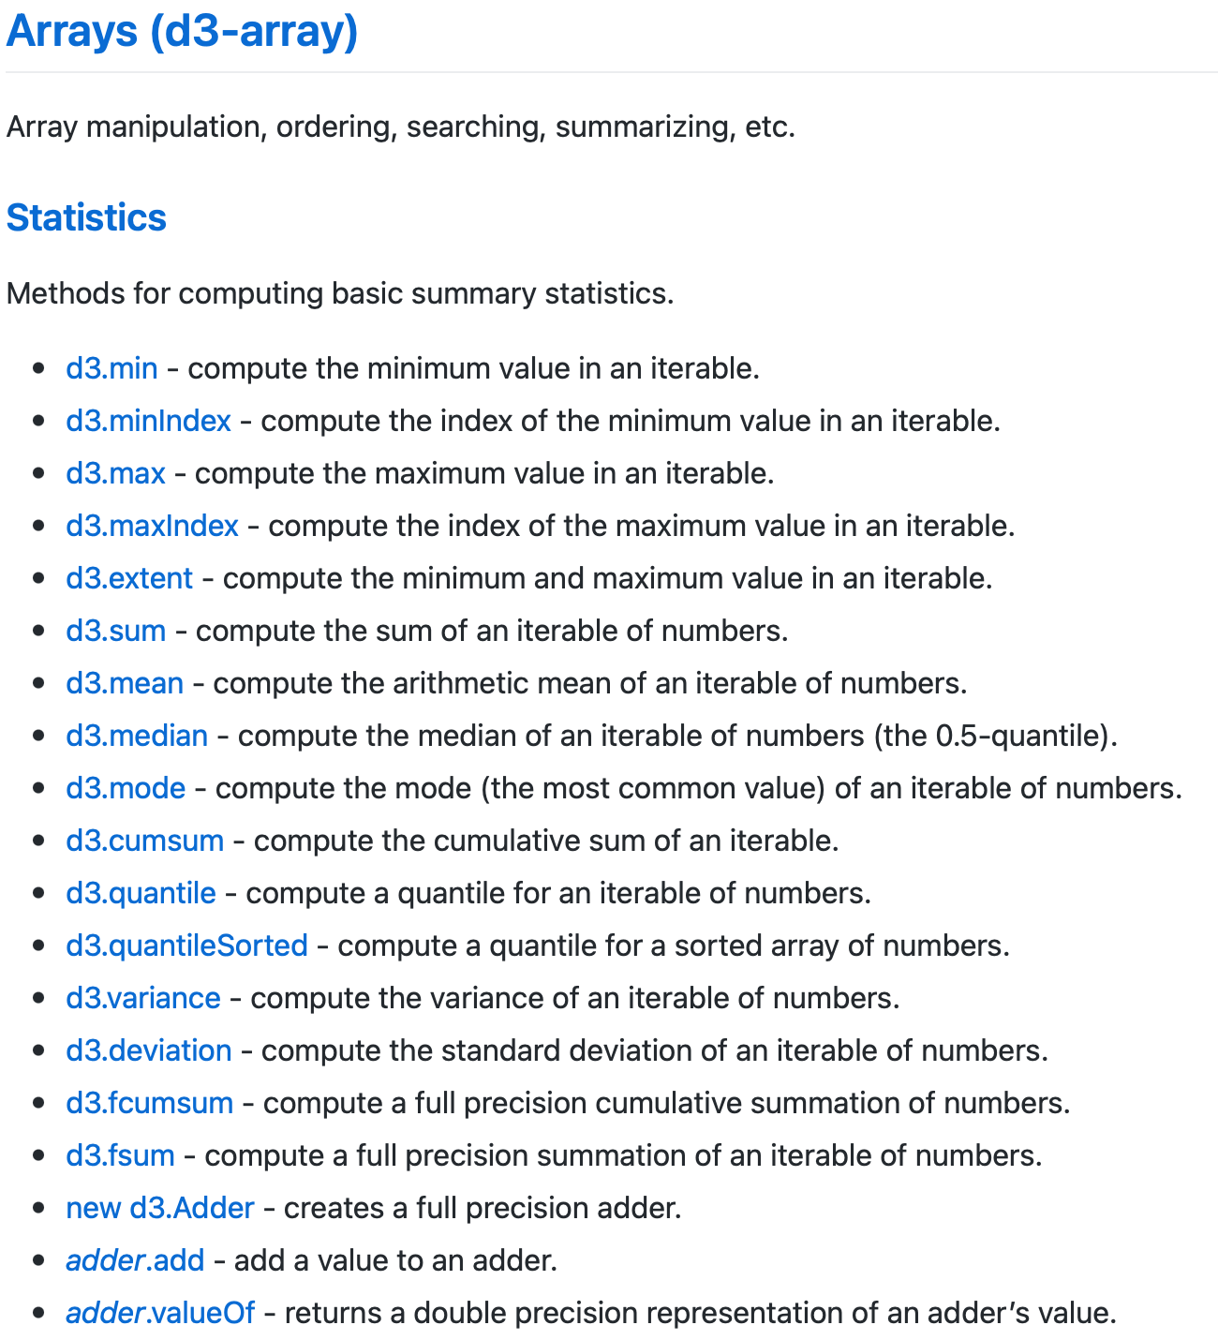
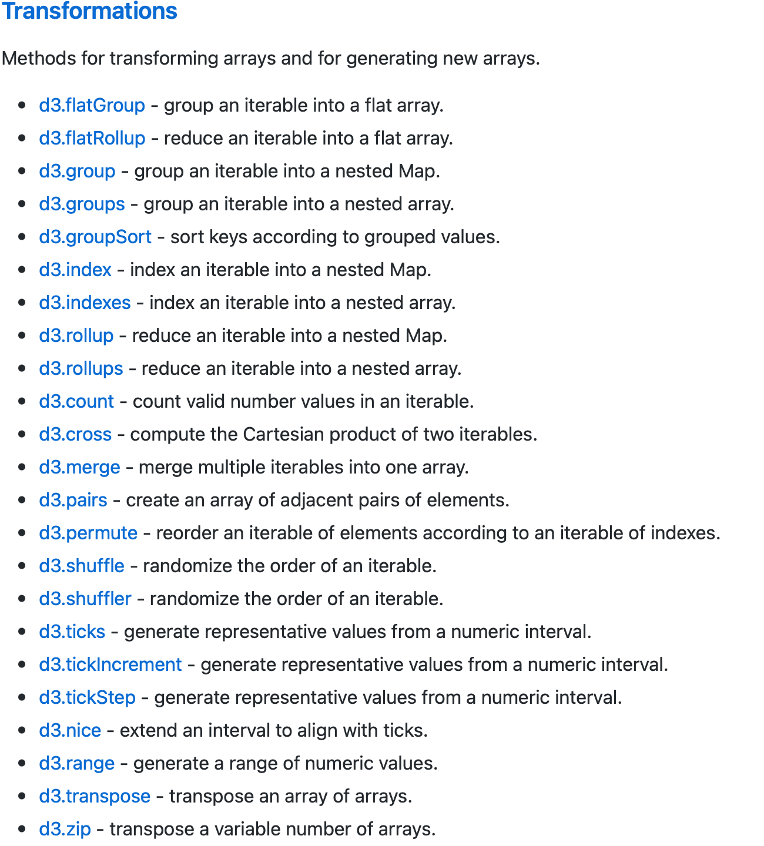
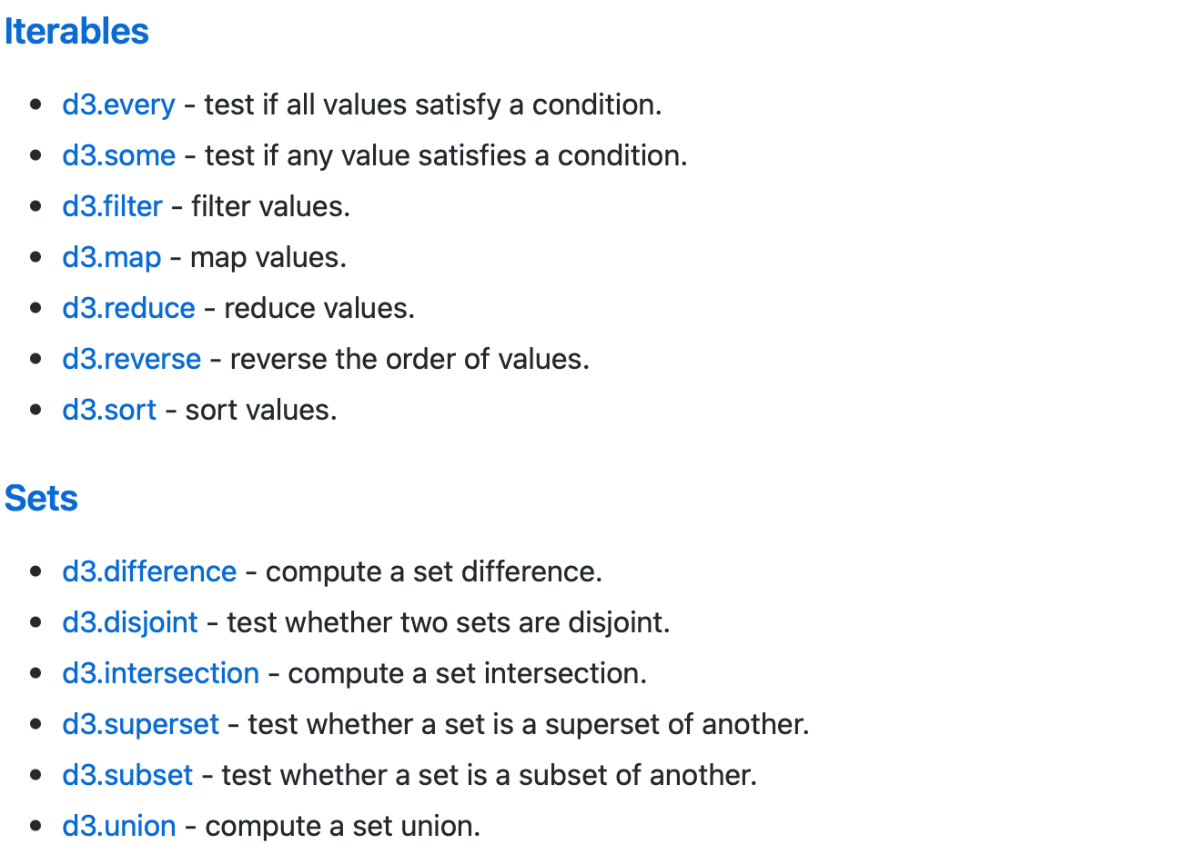
Preprocessing
D3-array.pdf
From Raw data To Visualized data

Slide 8
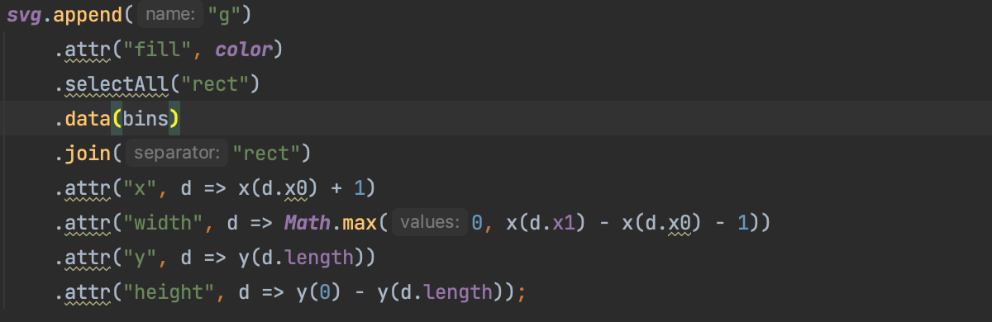
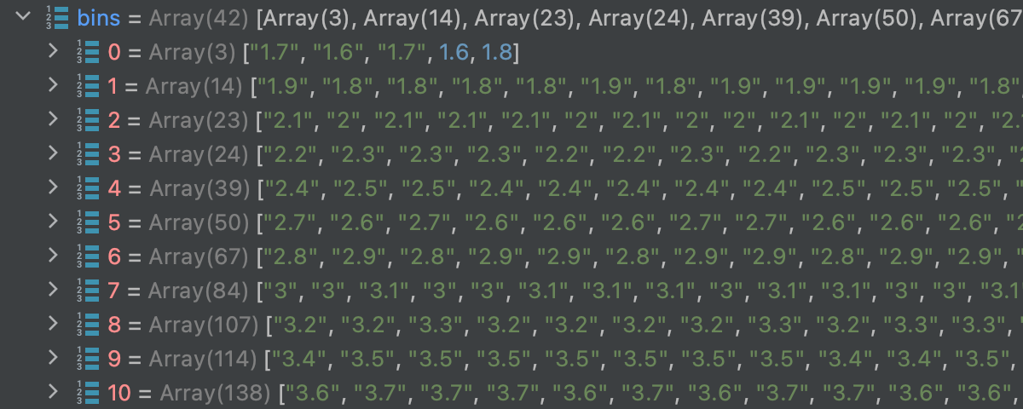
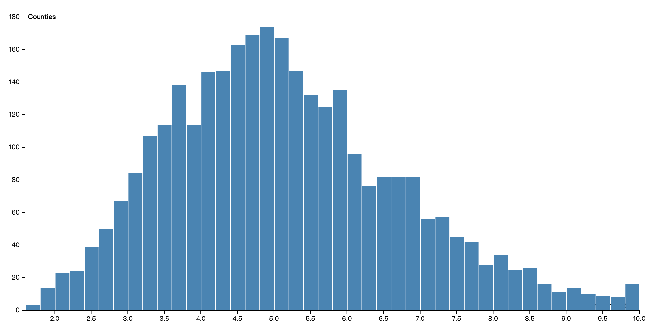
Data Join
selectAll -> data -> join

